Slide 1



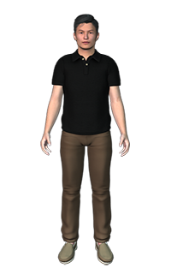


Document Verification
Moderation
How to verify the documents quickly?
How to moderate and validate document
Document Repository
Document Sharing
How to store the documents in document repository so that it can be shared with others
How to share document with permissioned and consent based
Vihan
Registrar – Land Records
Notes:
Stage 2:
Leading Banks like ICICI , Federal Bank have built their applications on IBM MobileFirst Platform.
IBM Campaign helps marketers design, execute, measure and optimize outbound marketing campaigns.
IBM Security Trusteer products deliver an intelligence-based, cybercrime prevention platform that helps prevent the root cause of fraud

Slide 2




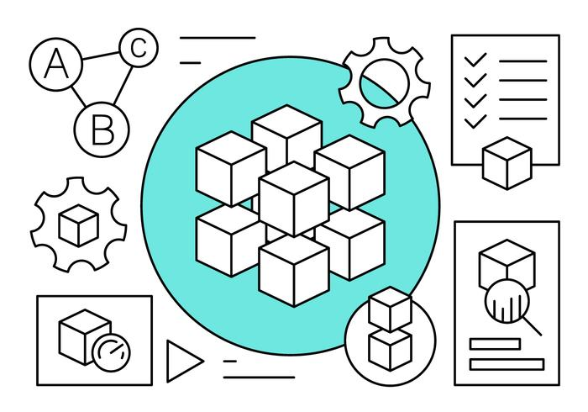
“Shared Land Records - Blockchain”
Permissioned, consent driven Land Records Platform
Shared Ledger
Notes:
Stage 2:
Leading Banks like ICICI , Federal Bank have built their applications on IBM MobileFirst Platform.
IBM Campaign helps marketers design, execute, measure and optimize outbound marketing campaigns.
IBM Security Trusteer products deliver an intelligence-based, cybercrime prevention platform that helps prevent the root cause of fraud

Slide 3




Seller(member)
artificial intelligence(AI Regulator)
Document
Registrar(Regulator)
Shared Ledger
Buyer/Agent(partner)
Notes:
Stage 2:
Leading Banks like ICICI , Federal Bank have built their applications on IBM MobileFirst Platform.
IBM Campaign helps marketers design, execute, measure and optimize outbound marketing campaigns.
IBM Security Trusteer products deliver an intelligence-based, cybercrime prevention platform that helps prevent the root cause of fraud

Slide 4
Document Verification by AI
(AI Regulator)
Notes:
Stage 2:
Leading Banks like ICICI , Federal Bank have built their applications on IBM MobileFirst Platform.
IBM Campaign helps marketers design, execute, measure and optimize outbound marketing campaigns.
IBM Security Trusteer products deliver an intelligence-based, cybercrime prevention platform that helps prevent the root cause of fraud

Slide 5
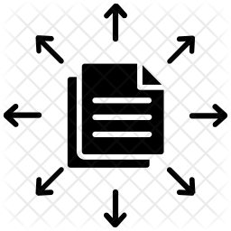
Buyer/Agent(partner)
Document Sharing – Consent based
Seller(member)
Notes:
Stage 2:
Leading Banks like ICICI , Federal Bank have built their applications on IBM MobileFirst Platform.
IBM Campaign helps marketers design, execute, measure and optimize outbound marketing campaigns.
IBM Security Trusteer products deliver an intelligence-based, cybercrime prevention platform that helps prevent the root cause of fraud

